Slide 1
Intro to Simulations
Yoshi Goto Apr 5 2018

Slide 2
Announcements
Switching subteams
Pre-reqs still stand!
Update us on your summer plans
Project development
Canvas page!
Everyone is included in case we have announcements.

Slide 3
Class Philosophy
Don’t be afraid to ask questions – anytime
You can interrupt me anytime
This is a reading, math, programming, and common sense class
We are a pro-device class
You’re all adults, you know how to pay attention
Think flexibly
Computational simulations of biology is literally taking two ends of a spectrum
Don’t be afraid to ask questions
Seriously. This is not an easy topic. We are covering topics from BIOEN 336,423,424,485.

Slide 4

Today’s Goals
What are Simulations?
What questions are simulations poking at?
Why simulations?

Slide 5
What are Simulations?

Slide 6
Wait…. Wasn’t this “modeling”? Or “Computational Biology”???
Or computational modeling or computational simulations or bioinformatics or genomics….
Notes:
No it’s none of these things, but parts of these things.

Slide 7
No, you dummy! :D

Slide 8
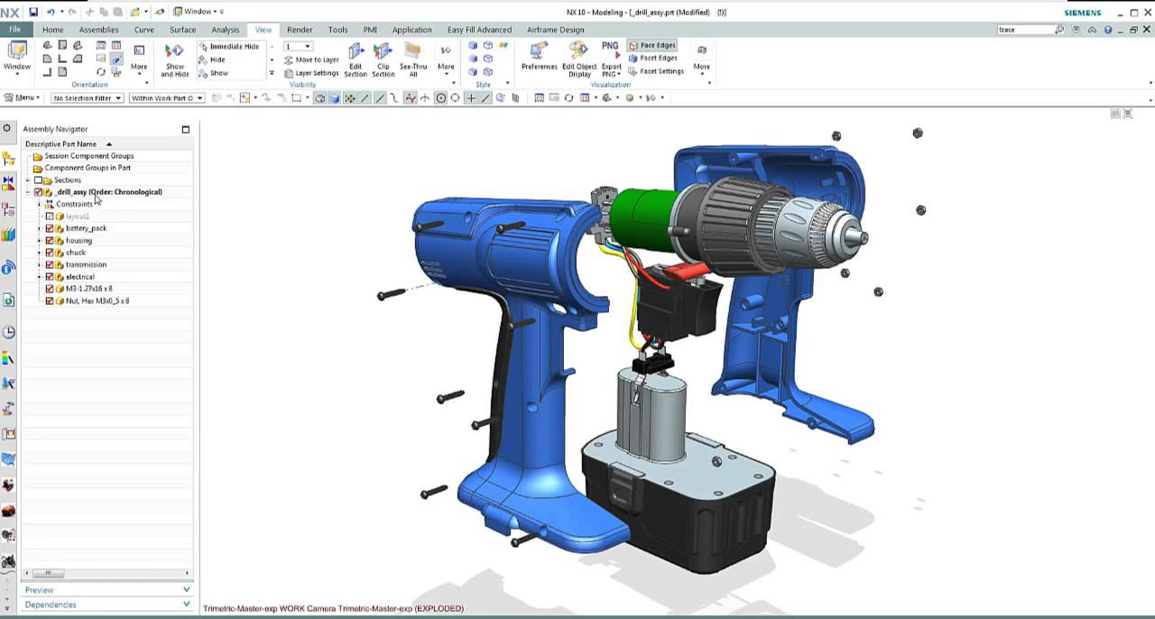
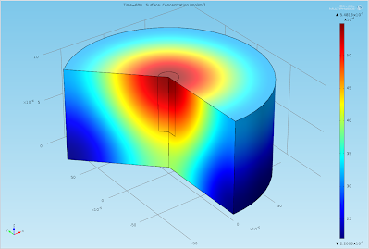
Not “modeling” or “CompBio”
Modeling is too broad
Overlaps with CAD – creating 2D/3D representations of objects
CompBio is too “narrow”
Multiphysics modeling (COMSOL/Ansys Modeling) is not CompBio

Slide 9
Ok Yoshi…. Then what is a “Simulation?”
We build computational models in order to simulate real systems, to get data
Just like a physical experiment, our ultimate goal is to get data from an “experiment”….
But we need a “thing”, a model, to run an experiment on!
“It takes 364 days to build your model or program, and 1 day to actually run the experiment” – Prof. Sauro, circa Spring, 2017

Slide 10
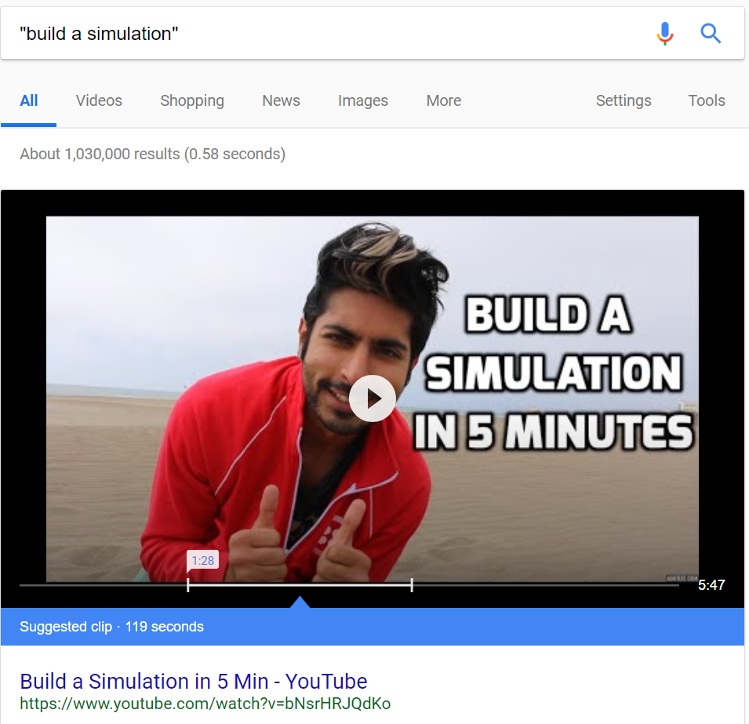
Notes:
You don’t “build simulations”! You build models that capture the behavior of the system being modeled. And if the model is a program, you run the program according to an “environment” you set, that the system responds to --- this is a simulation.

Slide 11

To gain a better understanding of how computer modeling works, let’s think about baking a cake that has 20 ingredients. If you want to know how each ingredient contributes to the outcome of the cake, one option would be to bake 20 cakes and leave out a different ingredient each time. Such an approach would be extremely time-consuming. Alternatively, you could enter all 20 ingredients into a computer model, explaining to the computer what each ingredient does and how it interacts with other ingredients. You could then run a simulation in which a different ingredient is left out each time. In a matter of seconds, the computer could tell you how each of the 20 cakes would likely turn out if baked in real life.
Let’s say you now want to know how changing the amount of each ingredient will affect the cake. In your computer model, you could adjust the amounts of each of the 20 ingredients any number of times until the outcome of your simulation is a cake that suits your needs (e.g. fluffy, sticky, soft, hard, etc.). In real-life, you would need to bake 190 cakes to find out the results of changing any 2 ingredients; 1,140 cakes to find the results of changing any 3 ingredients; and 4,845 cakes to find the results of changing any 4 ingredients. The power of computational modeling is that it allows scientists and engineers to simulate variations more efficiently by computer, saving time, money, and materials.
–THE NIH
This Photo by Unknown Author is licensed under CC BY-NC-SA

Slide 12
A simulation
Should be “correct”
Is never perfect
Should allow us to learn something new
Notes:
These might be basic questions, but they are good questions to already start thinking about, as they form the basis behind what the simulations team will do and how we generate “data” that might be useful to our experiment, or making the model better.

Slide 13
What questions are we solving poking at?
Notes:
7:05

Slide 14
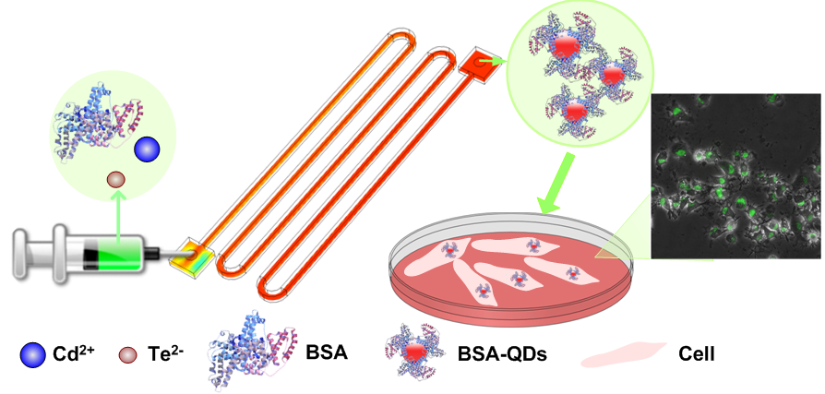
Let’s do an activity…
Notes:
The activity:
You are tasked with simulating a fluidic device. Your PI wants you to make a microfluidic device that will work to functionalize BSA proteins with Quantum Dots. What happens afterwards is someone else’s responsibility.
Quantum dots are as expensive as they sound. The fluidic device needs to be medical grade, so they want to use your free labor to model this first.
What parameters and questions do we need to ask in order to model this correctly?

Slide 15
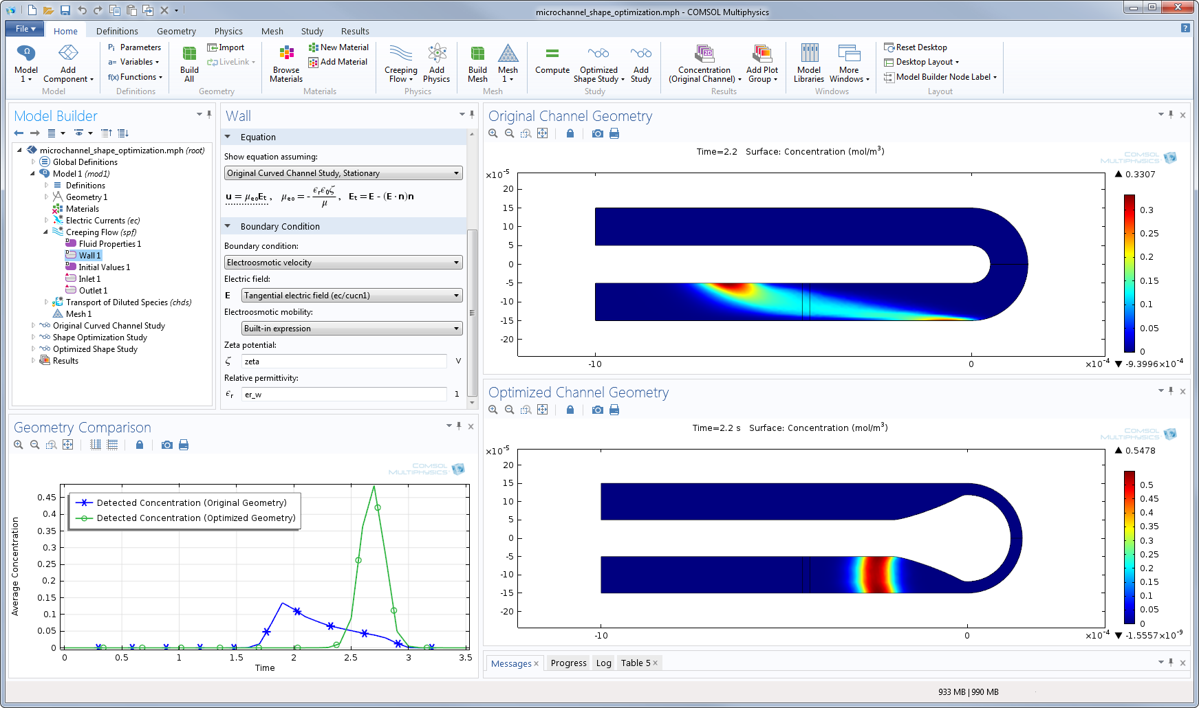

Slide 16
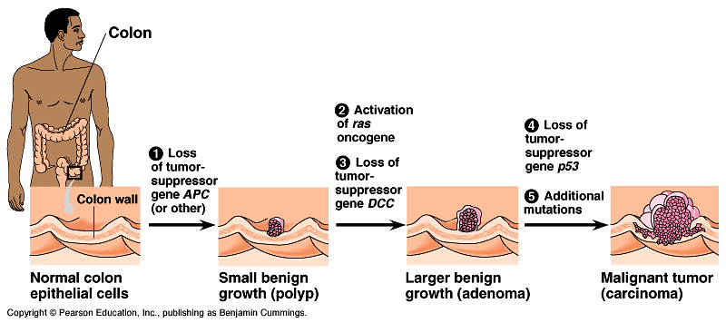
Notes:
Oncogene example

Slide 17
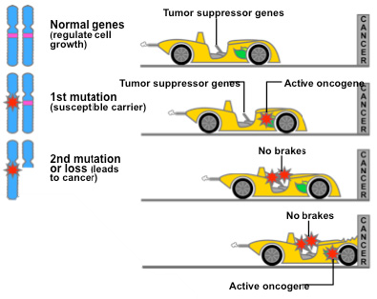
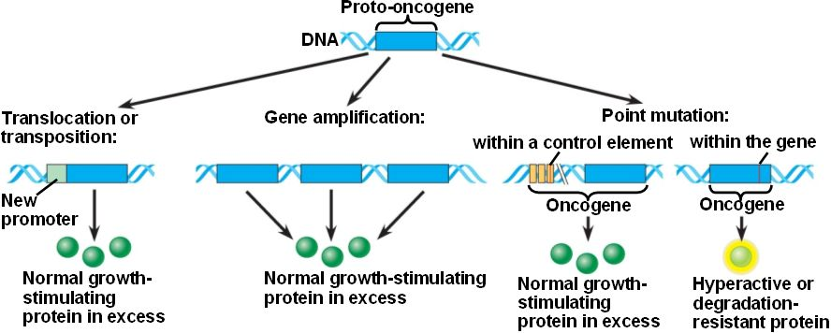

Slide 18
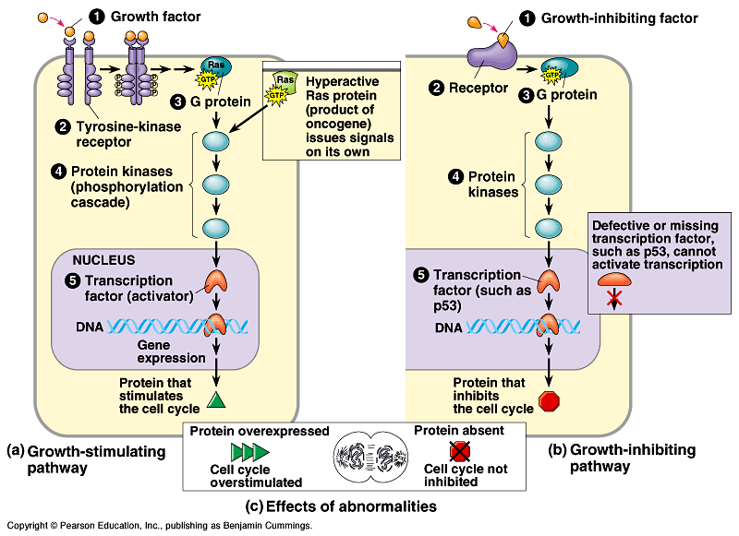

Slide 20
Questions
Microfluidics
Fluid dynamics to model liquid behavior- mixing
Parameters that we have to change – ex. Diameter of tubing, volume of syringe, media type, pH, viscosity,
Relative concentrations
Protein/Gene modeling
Transcription factors: number of active TFs in healthy vs. malignant
How many,what, proteins: quantities, interaction behavior,
Signaling: mutated proteins vs. non-mutated
Notes:
This is a slide to add what ppl came up with

Slide 21
Why simulations?
Notes:
If we get to this, we’ll talk about what it’s ultimately leading to.
HW for simulations team

